Slide 1
Care Team Value Set Project for representing Care team and care team member types
Stephen Chu PCWG
2017-01-09
Notes:
Change log – changes to this version:
(1) Added – Clinical research focused team: slide 13, 14, 18
(2) Replace FHIR CareTeam structure with version1.90 CareTeam structure (Slides 19 to 24): CareTeam.type -> CareTeam.category

Slide 2
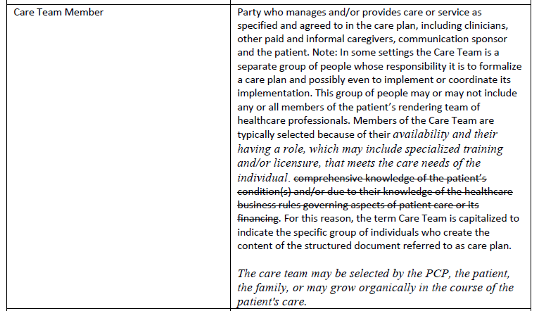
Care Team Definition: Current Works
Care team member examples:
Patient, Family, Carer, Delegate(s)
Patient
Caregiver/carer; agent
Provider, clinician
Generalist/PCP
Specialist
Cardiologist
Endocrinologist
…….
Allied health provider
Physical therapist
Podiatrist
Pharmacist
Dietitian/nutritionist
Clinical psychologist
……
Nurse, clinical nurse specialist
Care coordinator, care manager
Case manager
Discharge planner
Patient navigator
Support Services
Food delivery
Ride services
Source: HL7 PCWG Care Plan DAM – Care team member (source: ONC LCC)

Slide 3
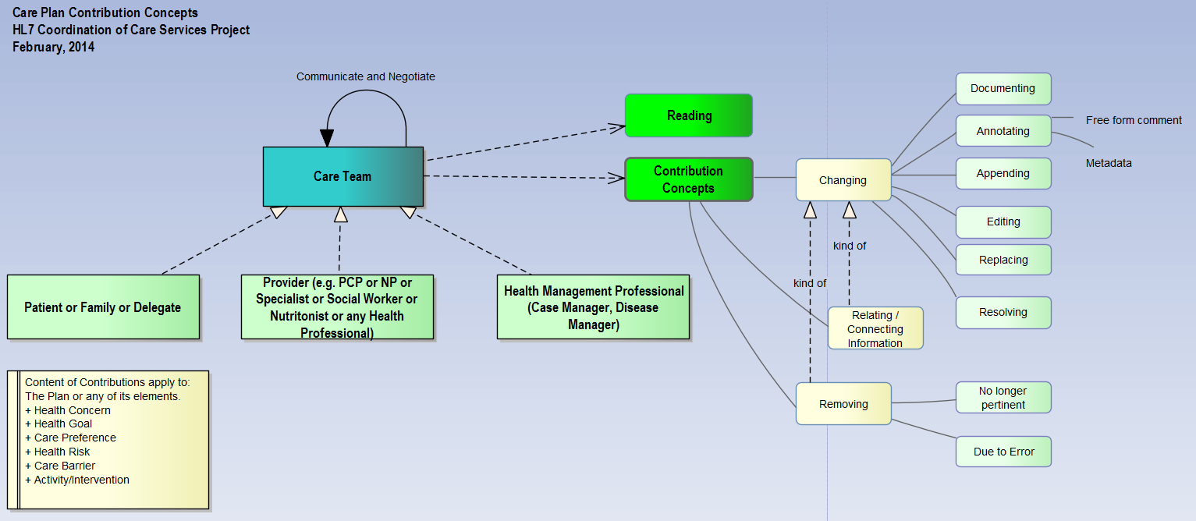
Care Team Definition: Current Works
Source: CCS DSTU
HL7 CCS Functional Model DSTU identifies three broad categories:
Patient, family, carer/delegate(s)
Provider
Care/Disease management professionals

Slide 4
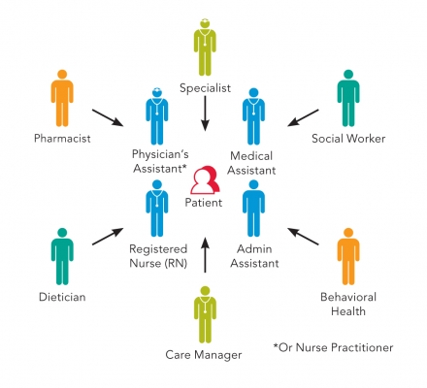
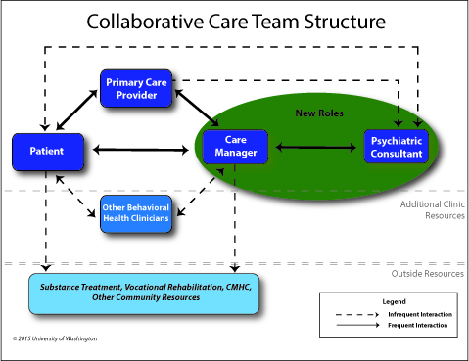
Care Team Definition: Current Works
Other international works: Patient-centered and Collaborative Care focused teams

Slide 5
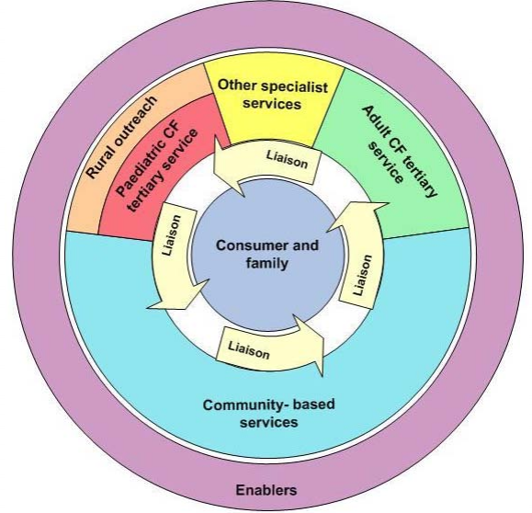
Care Team Definition: Current Works
CF Community-based care
team:
General Practitioners,
Community Physiotherapist
Clinical psychologist
Dietitian
community nurses
social worker
teacher
family
CF Tertiary Care Team:
respiratory physicians,
nurse practitioner,
clinical nurse consultants,
clinical psychologists,
social workers,
dieticians,
physiotherapists,
occupational therapists,
pharmacists,
clinical microbiologists,
clinical geneticist
transplant coordinator
research coordinators
family
teachers
Note:
The care team types
defined in this slide is
Jurisdiction specific
(state of Western Australia)
and condition specific
It is not presented here as
representative example
Source: Cystic fibrosis (CF) care & services delivery model (Western Australia Health Department)
1/10/2017

Slide 6
Care Team Type: Literature

Slide 7
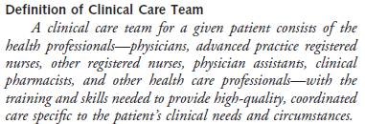
Care Team Types
Clinical care team
“Clinical care teams typically include, and are supported by personnel
who have a wide range of clinical, administrative, managerial, financial,
human resources, and other skills …”
Source: Doherty R, Crowley R, Principles supporting dynamic clinical care team: An American College of Physician
position paper, Annals of Internal Medicine, 2013;159:620-626

Slide 8
Clinical care team: examples
Chronic respiratory diseases care team
Cardiac/heart/CVS care team
Cystic fibrosis care team
Cancer/oncology care team
Diabetes care team
Palliative care team
Rheumatology health care team
http://www.rheumatology.org/I-Am-A/Patient-Caregiver/Health-Care-Team

Slide 9
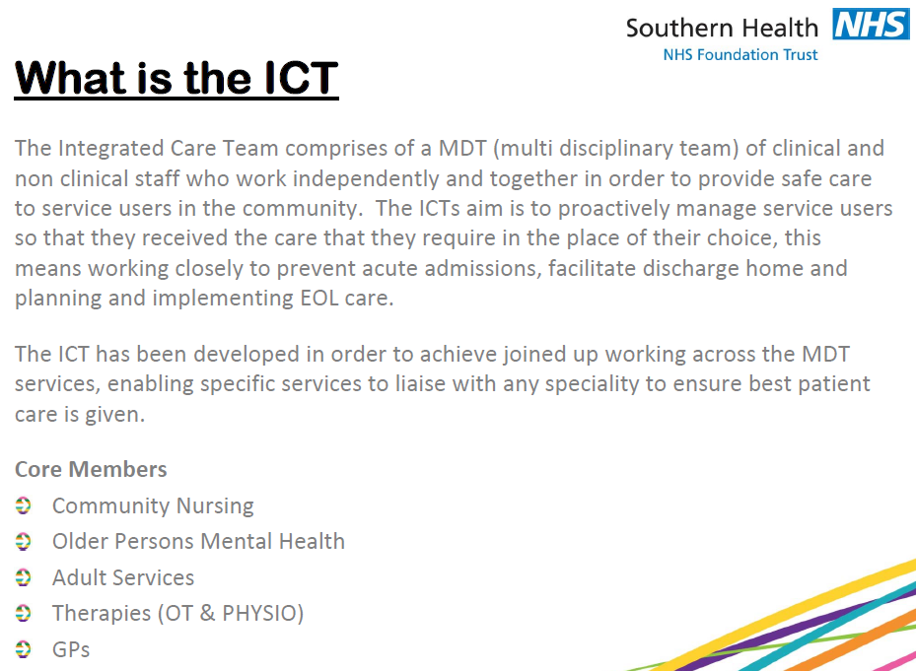
Integrated care team

Slide 10
Community Service Integrated Care Team
http://www.nottinghamshirehealthcare.nhs.uk/adult-community-services-integrated-care-team
The Integrated Care Team care for adults in their own homes, including care homes.
The team supports recovery, stabilising symptoms and helping people to manage their own conditions. Our patients may be housebound, elderly or frail and at risk of being admitted to hospital. We also support patients when they are discharged from hospital. We work closely with GPs and other health and social care workers to give the care and support needed by each patient
Our teams are made up of: • district/practice/community staff nurses • occupational therapists • physiotherapists • community matrons • specialist nurses • clinical nurse specialists in end of life care • health care assistants • social workers • mental health workers • self care advisors

Slide 11
Acute Care Team
https://metrosouth.health.qld.gov.au/sites/default/files/content/act_moc_final_web.pdf
The Acute Care Teams (ACT) deliver a face-to-face point of contact to Metro South Addiction and Mental Health Services (MSAMHS)
The key functions of the ACT are:
timely assessment and clinical interventions that lead to initial recovery planning, including relapse prevention and implementation for community consumers presenting with acute mental health needs
facilitation of access to the most appropriate mental health care— public mental health care and/or mainstream health care.

Slide 12
Support Services Team
http://www.dhs.state.il.us/page.aspx?item=50861
The Support Services Teams (SSTs) will provide an interdisciplinary technical assistance and training response to persons with a developmental disability in a medical or behavioral situation that challenges their ability to live and thrive in the community.
The SSTs will observe, assess, evaluate, consult with family members and providers working to support the person and provide training as necessary.
They will have nurses, Qualified Intellectual Disability Professionals (QIDPs), psychologists, and Board Certified Behavior Analysts on staff and have ready access to other needed specialty providers, such as psychiatrists

Slide 13
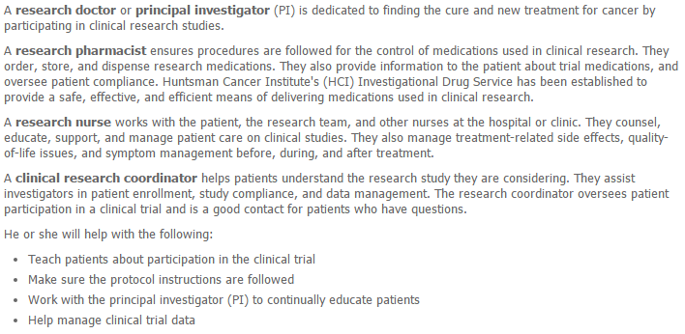
Clinical Research Focused Team
This type of team is responsible for establishing, conducting, coordinating and monitoring the outcomes of clinical trials. The team focuses on research, clinical care and education
http://healthcare.utah.edu/huntsmancancerinstitute/clinical-trials/the-research-team.php
The Research Team

Slide 14
Clinical Research Focused Team
https://ccts.osu.edu/education-and-training-programs/research-education-and-training-programs/clinical-research-coordinator-resources/responsibilities-of-the-research-team
The Research Team
Principal Investigator (PI)
Sub-Investigator (Sub-I) / Co-Investigator (Co-I)
Research Coordinator/ Research Nurse
Data Coordinator
Regulatory Coordinator
http://www.enttoday.org/article/how-to-form-a-clinical-research-team/
The Research Team
Principal Investigator (PI)
Co-Investigator (Co-I)
Clinical Coordinator
Statistician or methodologist

Slide 15
Care Settings Dimension
CF – Tertiary
care team
Community-care Setting
Tertiary-care Setting
Encounter
– Focused
Episode –
Focused
Encounter
– Focused
Episode –
Focused
CF – Community-based
care team
Care Coordination
– Focused
Condition-Focused
Care Coordination
– Focused
Condition-Focused

Slide 16
Care Settings Dimension
CF – Tertiary
care team
Community-care Setting
Community-care Setting
Encounter
– Focused
Encounter
– Focused
Episode –
Focused
Episode –
Focused
CF – Community-based
care team
Care Coordination
– Focused
Care Coordination
– Focused
Condition-Focused
Condition-Focused
Tertiary-care Setting
Tertiary-care Setting

Slide 17
Care Team Definition Project Working Progress

Slide 18
Care Team Types
Term | Definition
Event-focused | This type of team focuses on one specific incident. The incident is determined by the context of use Examples: code team (code red, code blue, MET).
Encounter-focused | This type of team focuses on one specific encounter. The encounter is determined by the context of use.
Episode-focused | This type of team focuses on one specific episode of care. The episode of care is determined by the context of use.
Condition-focused | This type of team focuses on one specific encounter. The condition is determined by the context of use.
Care-coordination focused | This type of team focuses on overall care coordination. The members of the team are determined or selected by an individual or organization. When determined by an organization, the team may be assigned or based on the person’s enrollment in a particular program.
Clinical research Focused* | This type of team is responsible for establishing, conducting, coordinating and monitoring the outcomes of clinical trials. The team focuses on research, clinical care and education
Source: HL7 Care Team Value Set Definition Project
Notes:
* Focus on clinical research to exclude pre-clinical trial phase of reaseach

Slide 19
Care Type Team Hierarchy
Care Team
In scope
Patient-Centered Care Team
Encounter-Focused
Episode-Focused
Condition-Focused
Care Coordination-Focused
Out of scope
Non-Patient Centered Care Team
Event-Focused
Teams designed to respond to incidents/events
Encounter-Focused
In some healthcare settings/organisations, the care
team functions are optimised around predetermined
workflow, which are often not necessarily patient
centric
Episode-Focused
Clinical research focused

Slide 20
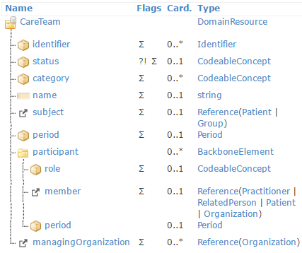

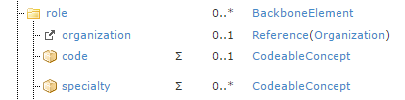

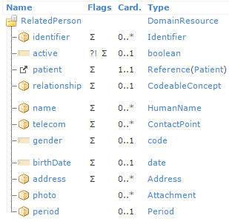
Care Team Resource - structure
…..
FHIR CareTeam and Practitioner structures
Data elements relevant to team types and roles are marked with
red boxes
Note – the Patient, RelatedPerson and Organization resources
do not contain “role” data element

Slide 21
Care Team Resource - structure
FHIR description:
Identifies what kind of team.
This is to support differentiation between multiple co-existing teams, such as:
care plan team
episode of care team
longitudinal care team
Replace with green
FHIR has not defined a formal value set for care team category.
The examples in FHIR documentation
aligns quite well with the types defined by the Care Team definition project:
Encounter focused
Episode of care focused
Condition focused
Care coordination focused
Making use of the
0..* cardinality
Oncology care team
medical oncology
surgical oncology
allied health
oncology social service
home care team
support service team
Cardiology care team
CF tertiary care team
CF community based care team
Palliative care
…
* Episode of care focused
CF tertiary care team
* Care coordination focused
Oncology care team
* Care coordination focused
Respiratory care team
Issue: Current FHIR Care Team does not provide structure/”home”
for clinical and support function care teams
Possible option – allow 0..* values on CareTeam.type element
Example – for patient with breast cancer:
Care coordination focused
Oncology care team

Slide 22
Care Team Resource - structure
NUCC?
FHIR description:
Roles which this practitioner is authorized to perform for the organization, example:
Doctor
Nurse
Pharmacist
Researcher
Issue – because patient | related person | organisation does not have a
“role” attribute, if the participant.role element only holds RACI value,
this may lead to loss of useful information, e.g. related person as carer
patient as coordinator
FHIR description:
Indicates specific responsibility of an individual within the care team, such as:
Primary physician
Team coordinator
Caregiver
Does this concept belong elsewhere?
Is CareTeam.participant.role element the appropriate
attribute for care plan/care activity responsibility values?
Option 1 Option 2 Option 3
Accountable Accountable Care plan author
Responsible Control Care plan owner
Consulted Suggest Care plan recommender
Informed Perform
Issue – A person may not have a Care Plan, they may only have a CareTeam.
Does RACI work without a Plan?
Other “levels of responsibility”
Notes:
Other “levels of responsibility” could be associated with a care team member and might be independent of the “plan”. Even if there is no Care Plan, we may need a place to record, for each care team member, something about their responsibility.
NUCC has a lot of gaps. Sometimes you might need to reference more than one NUCC concept.
RelatedPerson and Patient Resource don’t included places to hold concepts that would indicate the levels of skills or care services/capabilities that they contribute. This may be a gap for these resources.
We need to be able to show the level of responsibility in the care team resource, so the attribute may be better added to the participant (above practitioner, patient, relatedPerson)
How many attributes do we need?
CareTeam.Participant.skill – what types of services is the person contributing?
CareTeam.Participant.responsibility – a RACI type of concept
CareTeam.Participant.HealthLiteracy – what types of knowledge/training/capabilities does the participant have relative to the condition they are managing/having to deal with?
Is this thought through enough to enter a gForge request? This would be a starting point for more discussion of this need. It would raise more discussion in the PC FHIR meeting to move this toward action once it is further reviewed and vetted. Same sample value sets would be helpful to include in the request. Do 80% of the systems support this? Do they support having these additional (multiple attributes).
Michell’s experience: a single role depending on what the member type. Practitioners have one set, RelatedPerson have a different relationship to the patient concepts. Encounter or Visit-specific Assignment type for the visit (dietary activities, PT, OT, spiritual guidance) assignment during the encounter. In her experience: the “role column” is used in certain ways related to the context of the workflow. The structural component becomes a sort of “Role/Relationship/Responsibility” concept. None of these current “roles” include these other attributes. At the team-level, who is responsible for what? The responsibility seems more related to a activity/task that needs to be done.
An Outreach or Community Care team may have participants with other types of roles. Social Worker is also a role.
The Gforge ticket, if added, should request that an 80/20 discussion be conducted too. Emma reminded us that this is a very new area and the 80/20 rule may not apply. We can’t be constrained to only what has been done by 80% of systems in the past.
Russ – supports submitting it as a change request.
Could implementers also collect this list of “role and relationship” types?

Slide 23
Care Team Resource - structure
Suggested clinical/care activity
specific role values:
Medical oncologist
Oncology nurse specialist
Oncology clinical pharmacist
Consultant pulmonologist
Clinical nurse specialist
Case manager
…
FHIR description:
Roles which this practitioner is authorized to perform for the organization, example:
Doctor
Nurse
Pharmacist
Researcher
Clinical specialty values:
Oncology
Respiratory medicine
Cardiology
…

Slide 24
Care Team Resource - structure
…..
NUCC Licensure value set
Note – current FHIR CareTeam, Practitioner,
RelatedPerson, Organisation do not include
structure/data element to support inclusion of
funding and funding source information

Slide 25
Care Team – breast cancer use case
Clinical scenario:
A 58 year old female diagnosed with Stage IIB breast cancer (pT2: >20mm and <50mm in
greatest diameter; pN1a: 1-3 axillary lymph nodes, 1LN > 2.0mm)
Treatment: surgical excision + radiation therapy + chemotherapy
Breast cancer care plan
Care Team
 | CareTeam. category |  |  |  |  | Care coordination focused Oncology care team
 |  | participant. role |  |  |  | Accountable (surgeon) Responsible (nurse)
 |  |  | member. practitioner.role.code |  |  | Surgical oncologist Oncology nurse specialist Physical therapist ..
 |  |  |  | Practitioner. role.specialty |  | Oncology Oncology nursing
 |  |  |  |  | practitioner. qualification.code | NUCC codes

Slide 26
Care Team – asthma use case
Clinical scenario:
A 62 year old male widower who lives alone, is diagnosed with asthma, type II DM and
depression. Patient is non-compliant to asthma management plan and has12 repeated ED
encounter and hospitalisation in past 11 months
Asthma case management and care plan – a case manager/care coordinator is assigned
Care Team
 | CareTeam. category |  |  |  |  | Care coordination focused Asthma care team Home care team Support services team
 |  | participant. role |  |  |  | Accountable (physician) Responsible (nurse) Case manager (PCP)
 |  |  | member. practitioner.role.code |  |  | Pulmonologist Clinical nurse specialist Nurse coordinator ..
 |  |  |  | Practitioner. role.specialty |  | Respiratory medicine Clinical pharmacy
 |  |  |  |  | practitioner. qualification.code | NUCC codes

Slide 27
Further discussions

